Slide 1
C# & .NET Framework
Chapter 23:
ASP.NET 2.0 Web Pages and Web Controls

Slide 2
Review
ADO vs ADO .NET
The .NET 2.0 Provider Factory Model
Understanding the Connected Layer of ADO.NET
Working with Parameterized Command Objects
Understanding the Disconnected Layer of ADO.NET: DataAdapter / DataSet
Binding DataTables to User Interfaces.

Slide 3
Chapter 23: Objectives
The Role of HTTP
Understanding Web Applications and Web Servers
The Role of HTML.
The Role of Client-Side Scripting
Submitting the Form Data (GET and POST)
The ASP.NET Web Page Code Model
Details of an ASP.NET Website Directory Structure
The ASP.NET 2.0 Page Compilation Cycle.
Interacting with the Incoming HTTP Request
Interacting with the Outgoing HTTP Response
The Life Cycle of an ASP.NET Web Page
Building a Simple ASP.NET 2.0 Website
The Role of the Validation Controls

Slide 4
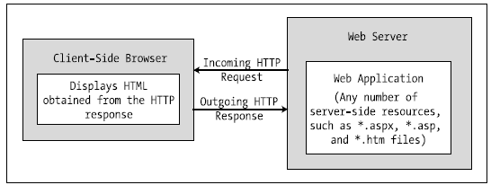
The Role of HTTP
HTTP (Hyper Text Transfer Protocol) is a text-based protocol that is built upon a standard request/response paradigm.
The HTTP request and response cycle
HTTP is an essentially stateless protocol

Slide 5
Web Applications and Web Servers
A web application can be understood as a collection of files (*.htm, *.asp, *.aspx, image files, etc.) and related components (such as a .NET code library) stored within a particular set of directories on a given web server.
A web server is a software product in charge of hosting your web applications, and it typically provides a number of related services such as integrated security, File Transfer Protocol (FTP) support, mail exchange services, and so forth.

Slide 6
Web Servers
IIS Virtual Directories
Each virtual directory is mapped to a physical directory on the local hard drive
The ASP.NET 2.0 Development Server
WebDev.WebServer.exe:
Allows developers host an ASP.NET 2.0 web application outside the bounds of IIS.
Helpful for team development scenarios and for building ASP.NET 2.0 web programs on Windows which does not support IIS).
It cannot be used to test classic ASP web applications.

Slide 7
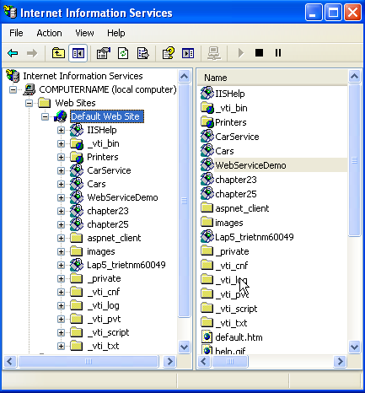
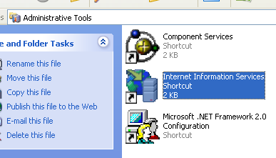
Web Servers
Create IIS Virtual Directories in IIS
Start/Program/Control Panel/Administrative Tools/Internet Information Services

Slide 8
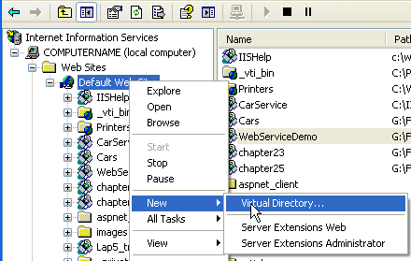
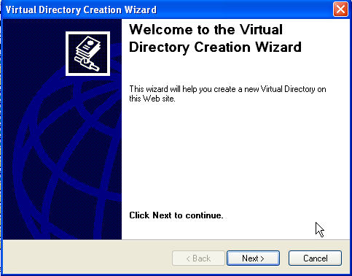
1
2

Slide 9
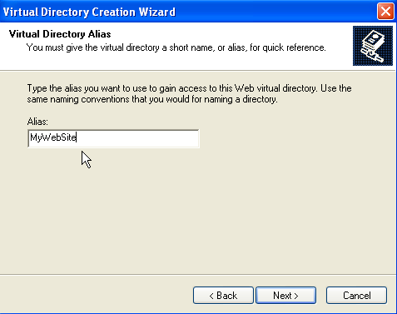
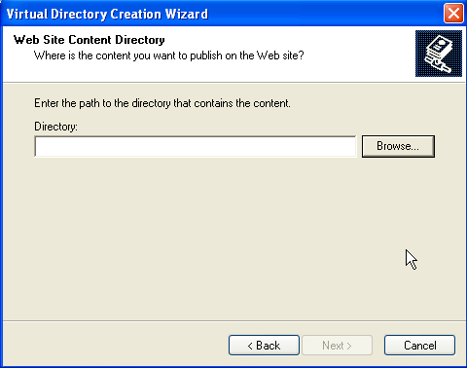
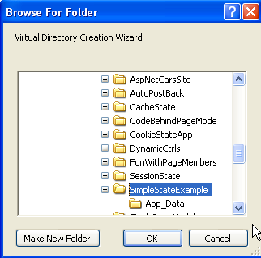
3
4
5

Slide 10
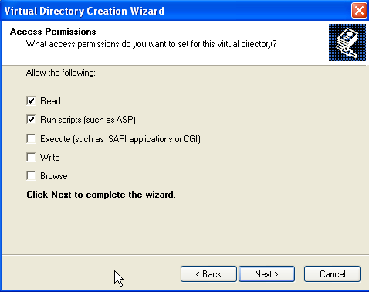
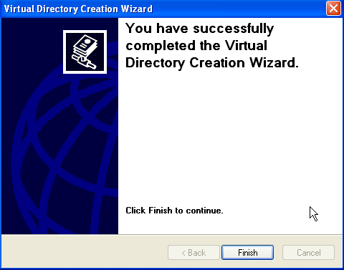
6
7

Slide 11
The Role of HTML
HTML is a language for describing web pages.
HTML stands for Hyper Text Markup Language
HTML is not a programming language, it is a markup language
A markup language is a set of markup tags
HTML uses markup tags to describe web pages
HTML Documents = Web Pages
HTML documents describe web pages
HTML documents contain HTML tags and plain text
HTML documents are also called web pages

Slide 12
The Role of HTML
HTML markup tags are usually called HTML tags
HTML tags are keywords surrounded by angle brackets, that begin “<” and finish with “>”, like <html>
HTML tags normally come in pairs like <b> and </b>
The first tag in a pair is the start tag, the second tag is the end tag
Start and end tags are also called opening tags and closing tags.
Web Browser
The purpose of a web browser (like Internet Explorer, or Firefox, etc) is to read HTML documents and display them as web pages.
The browser does not display the HTML tags, but uses the tags to interpret the content of the page

Slide 13
The Role of HTML
HTML Document Structure
An HTML file consists of a set of tags that describe the look and feel of a given web page.
<html> and </html>
<body> and </body>
<html>
<head>
<title>This Is the Cars Website</title>
</head>
<body>
……
</body>
</html>

Slide 14
The Role of HTML
HTML Form Development
The real action of an *.htm file occurs within the scope of the <form> elements.
An HTML form is simply a named group of related UI elements used to gather user input, which is then transmitted to the web application via HTTP.
<html>
<head>
<title>This Is the Cars Web Site</title>
</head>
<body>
<form id="defaultPage" name="defaultPage">
<!-- Insert web content here ->
</form>
</body>
</html>

Slide 15

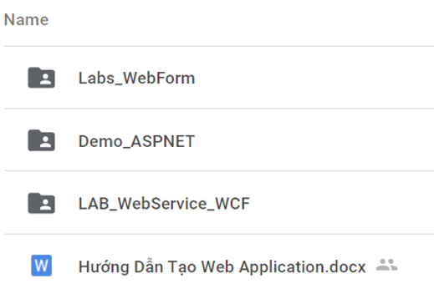
Create ASP.NET WebForm Application

Slide 16
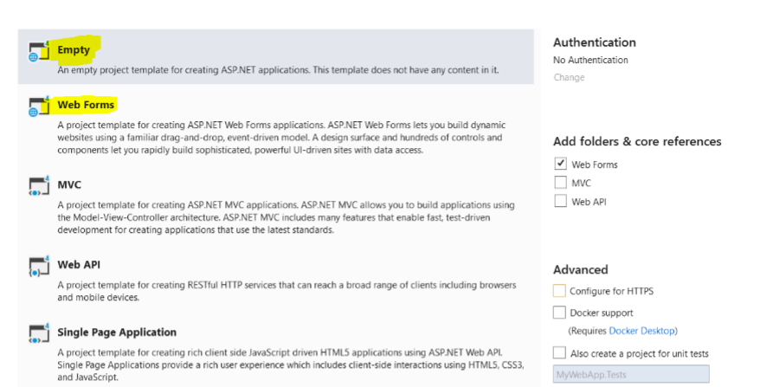
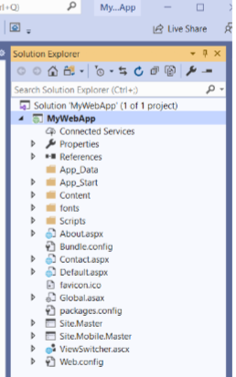
Create ASP.NET WebForm Application

Slide 17
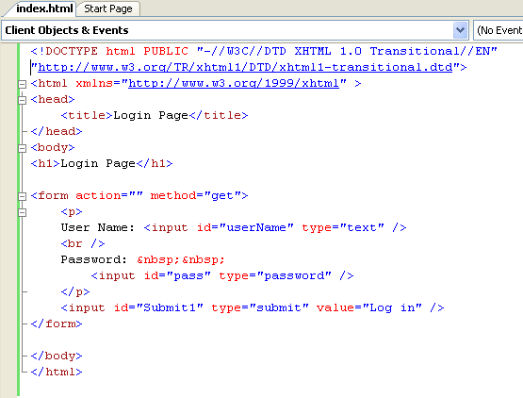
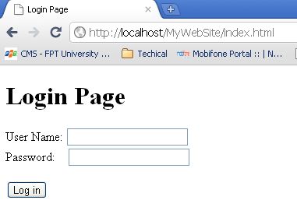
HTML - Example
To run this page, copy this page (index.html) to the directory pointed by the virtual directory created in previous slides. Then, open any web browser, and type: http://localhost/name_of_virtual_directory/index.html

Slide 18
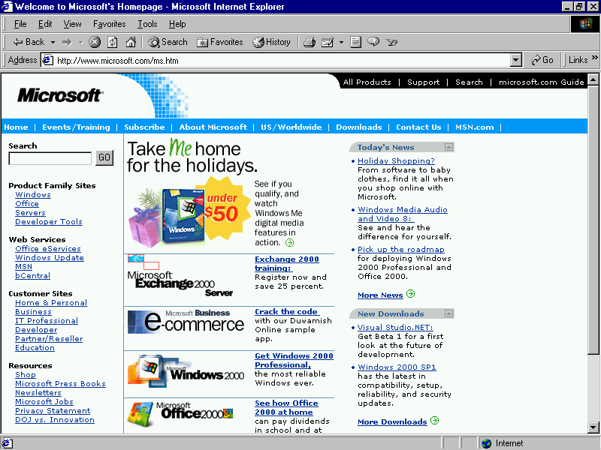
HTTP protocol/HTML page/Web Server
1. Convert http://microsoft.com/ to 192.168.54.3:80
Connect
2. Send a request to Web Server (index.html)
4. The result is responsed to Browser
http://microsoft.com/index.html
192.168.54.3:80
5. Web Browser views the result which contains a markup language
3. Web Server processes a request (connecting DB, calculating, call service …)
Request – Response pairs
Stateless
Port 80 is default

Slide 19
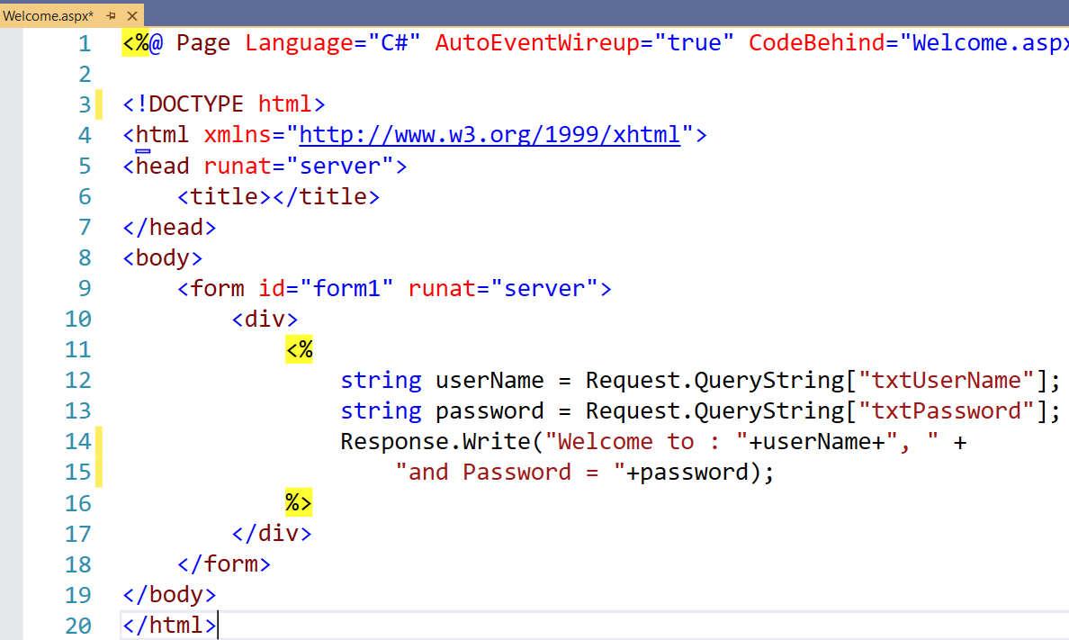
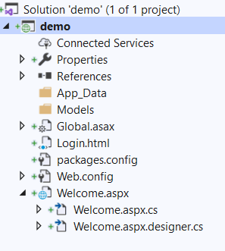
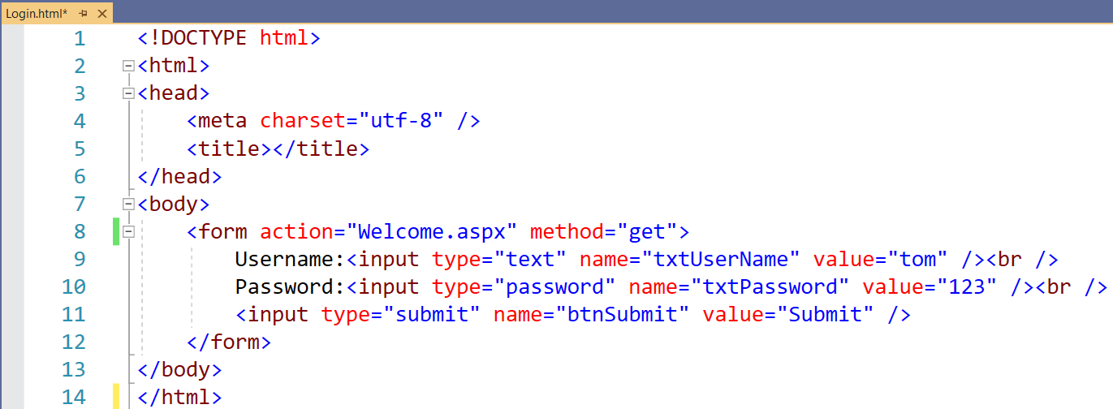
GET / POST

Slide 20
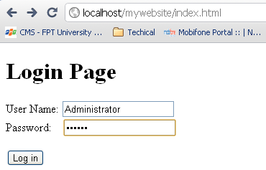
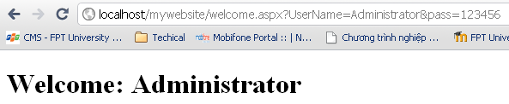
GET / POST
1. Form’s information is sent to Web Server using request parameter.
2. Server process requested client (server script – Server Side), connect DB ...
3. Connect
Submit data to server using GET
Database
4. The result of processing is responsed

Slide 21
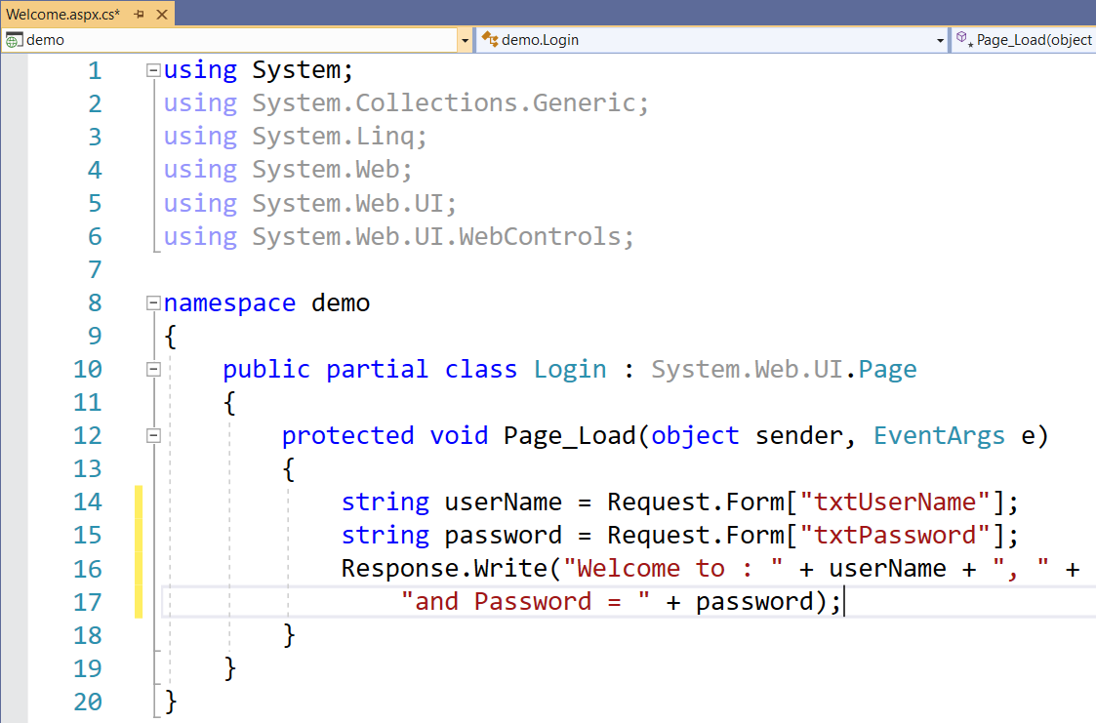
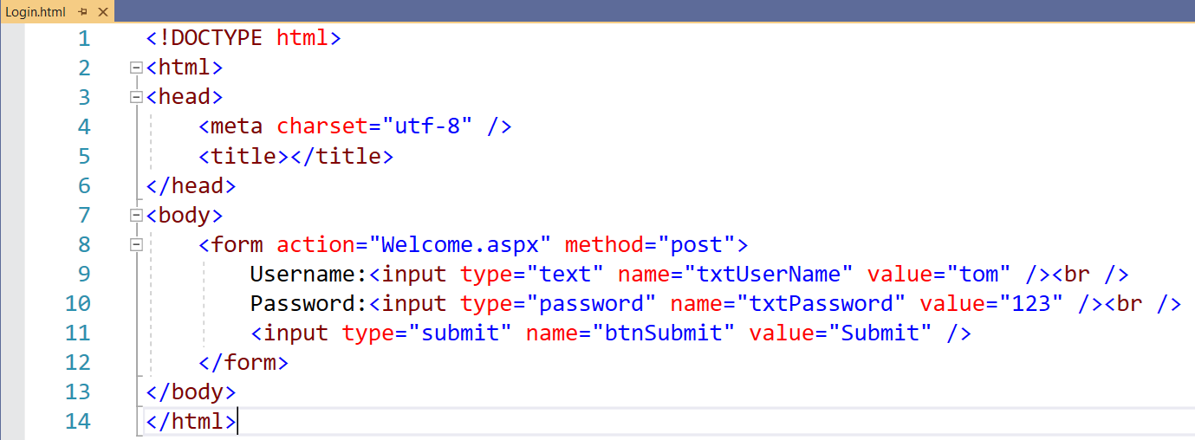

Slide 22
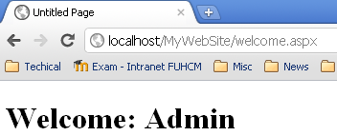
GET / POST
1. Form’s information is sent to Web Server using request parameter.
2. Server process requested client (server script – Server Side), connect DB ...
3. Connect
Submit data to server using POST
Database
4. The result of processing is responsed

Slide 23
GET vs POST
GET:
Is the method commonly used to request a resource/ get information (access static resource such as HTML doc and images or retrieve dynamic information such as query parameters) from server
The length of query string, that is introduced by the question mark “?”, is restricted 240 to 255
Is trigger by
Typing into the address line of the browser and pressing GO
Clicking on a link in a web page
Pressing the submit button in an HTML <form> whose method is set to GET
POST: sends data of unlimited length to the web server
Is the method commonly used for passing user input/ sending information to the server (access dynamic resources and enable secure data in HTTP request because the request parameters are passed in the body of request)
No limit of length and cannot be booked mark

Slide 24
The Role of Client-Side Scripting
There are two major reasons to use client-side scripting:
To validate user input before posting back to the web server.
To interact with the Document Object Model (DOM) of the target browser
Client scripts examples: VBScript, JavaScript.
VBScript:
Subset of the Visual Basic 6.0
Only supported by IE.
JavaScript:
In no way, shape, or form a subset of the Java language.
Have a somewhat similar syntax to Java.
Not a full-fledged OOP language,
Supported by all browsers.
Example: Ch_23 code\CarsWebSite\default.htm

Slide 25
ASP technologies
Classic ASP (3.0)
ASP .NET 1.x
ASP .NET 2.0

Slide 26
Classic ASP (3.0) Challenges
Coding overhead (too much code)
Everything requires writing code!
Code readability (too complex; code and UI intermingled)
Maintaining page state requires more code
Reuse is difficult
Supporting many types of browsers is difficult
Session state scalability and availability
Limited support for caching, tracing, debugging, etc.
Performance and safety limitations of script

Slide 27
Major Benefits of ASP.NET 1.x
ASP.NET 1.x provides a model termed code-behind, which allows you to separate presentation logic from business logic.
ASP.NET 1.x pages are compiled .NET assemblies, not interpreted scripting languages, which translates into much faster execution.
Web controls allow programmers to build the GUI of a web application in a manner similar to building a Windows Forms application.
ASP.NET web controls automatically maintain their state during postbacks using a hidden form field named __VIEWSTATE.
ASP.NET web applications are completely object-oriented and make use of the CTS.
ASP.NET web applications can be easily configured using standard IIS settings or using a web application configuration file (Web.config).

Slide 28
Major Enhancements of ASP.NET 2.0
ASP.NET 2.0 no longer requires websites to be hosted under IIS during the testing and development of your site.
ASP.NET 2.0 ships with a large number of new web controls (security controls, new data controls, new UI controls, etc.) that complement the existing ASP.NET 1.x control set.
ASP.NET 2.0 supports the use of master pages, which allow you to attach a common UI frame to a set of related pages.
ASP.NET 2.0 supports themes, which offer a declarative manner to change the look and feel of the entire web application.
ASP.NET 2.0 supports web parts, which can be used to allow end users to customize the look and feel of a web page.
ASP.NET 2.0 supports a web-based configuration and management utility that maintains your Web.config files.

Slide 29
ASP.NET Overview Architecture
VB
C++
C#
JScript
…
Common Language Specification
ASP.NET: Web Services
and Web Forms
Windows Forms
Visual Studio.NET
ADO.NET: Data and XML
Base Classes
Common Language Runtime

Slide 30
The ASP.NET Web Page Code Model
ASP.NET web pages can be constructed using one of two approaches:
Single-file page model:
A single *.aspx file that contains a blend of server-side code and HTML (much like classic ASP).
Server-side code is placed within a <script> scope
Languages to script code: C#, VB.NET,…
Advantages:
Easier to deploy or to send to another developer.
Because there is no dependency between files, a single-file page is easier to rename.
Managing files in a source code control system is slightly easier, as all the action is taking place in a single file.

Slide 31
The ASP.NET Web Page Code Model
Code-behind:
Separates your programming code from your HTML presentation logic using two distinct files.
Works quite well when your pages contain significant amounts of code or when multiple developers are working on the same website.
Advandtages:
It is possible to have designers working on the markup while programmers author the C# code.
Code is not exposed to page designers or others who are working only with the page markup (as you might guess, HTML folks are not always interested in viewing reams of C# code).
Code files can be used across multiple *.aspx files.

Slide 32
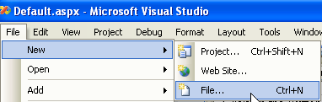
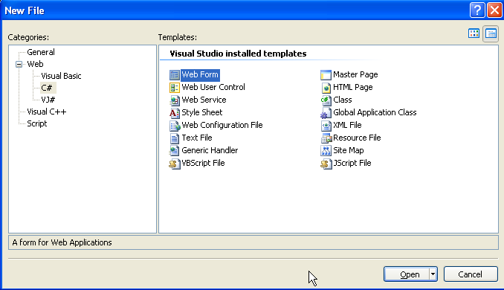
Single-File Page Model Demo (Ch_23 code\SinglePageModel)
1
2

Slide 33
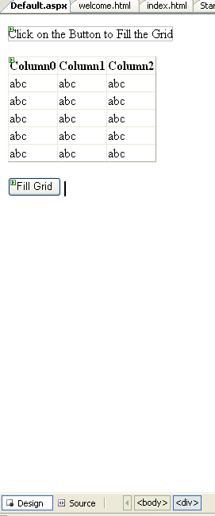
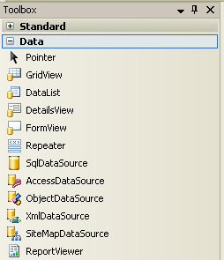
3

Slide 34
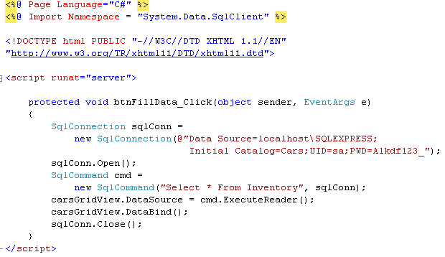
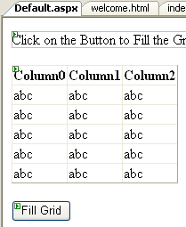
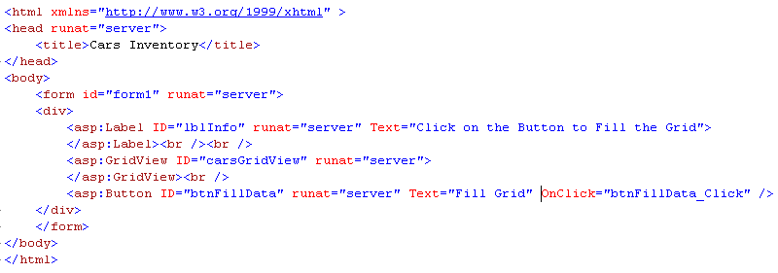
4

Slide 35
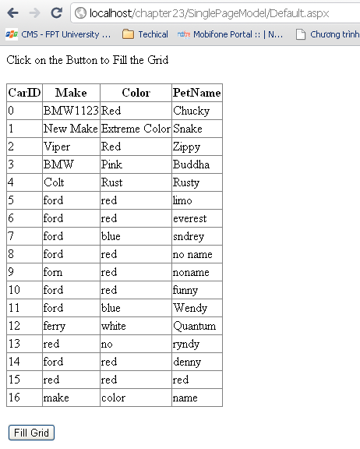
5

Slide 36
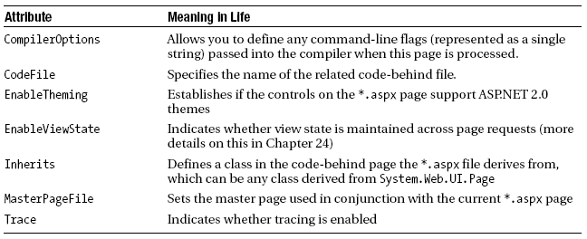
Single-File Page Model
The <%@Page%> Directive: Every *.aspx file must have at minimum a <%@Page%> directive that is used to define the managed language used within the page (via the language attribute)
The <%Import%> Directive: explicitly states the namespaces required by the current page.
Other directives: @ Register, @ Master, @ Assembly, …

Slide 37
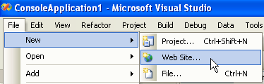
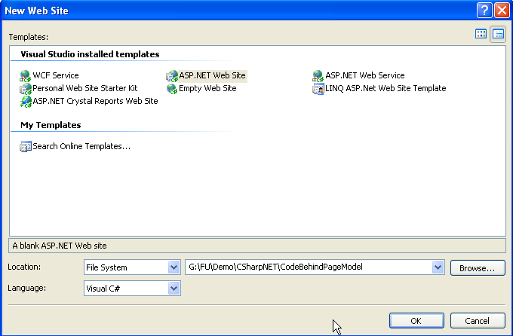
Code-Behind Page Model Demo
1
2

Slide 38
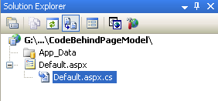
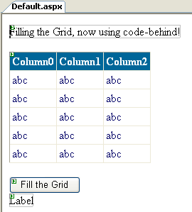
Contain HTML code
Contain C# code

Slide 39

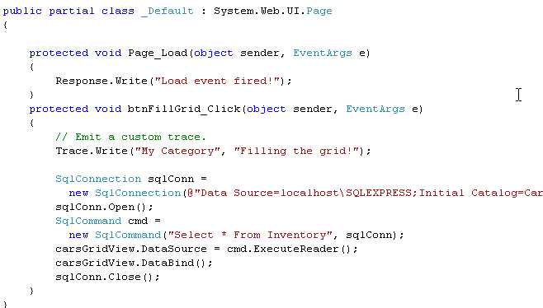
Default.aspx
Default.aspx.cs

Slide 40
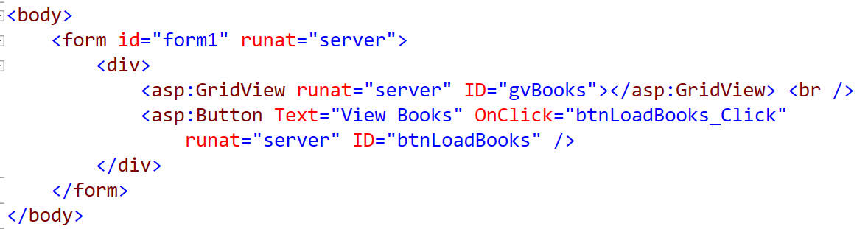
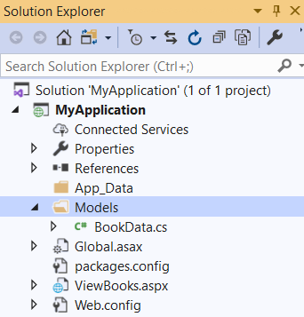
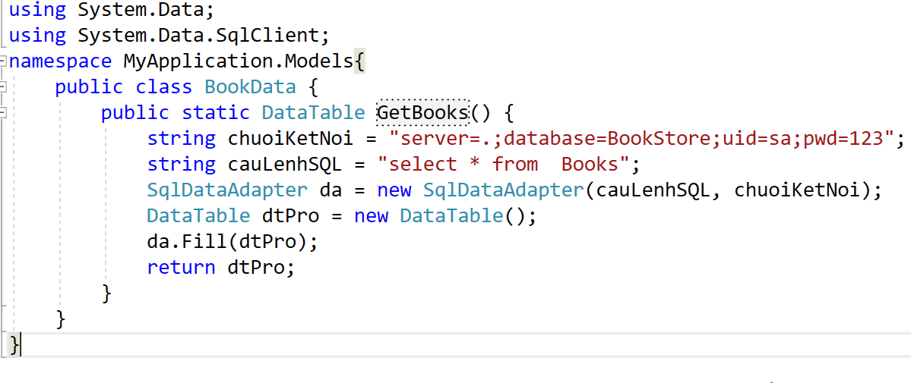
Demo

Slide 41
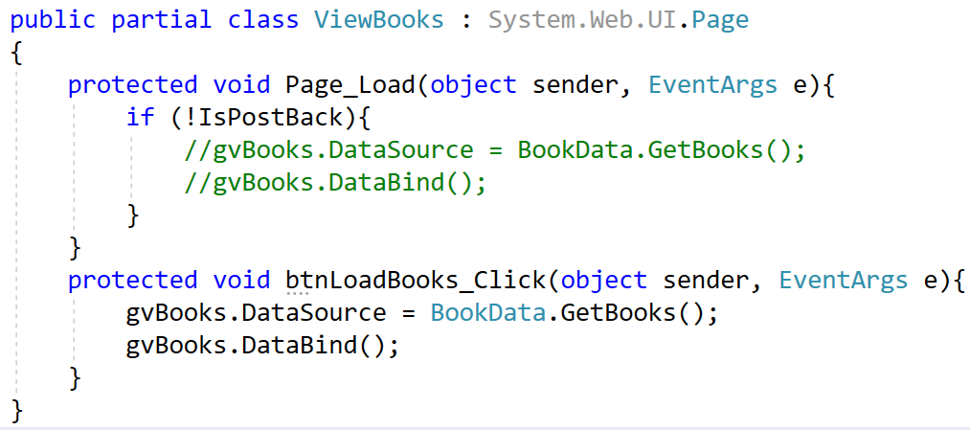
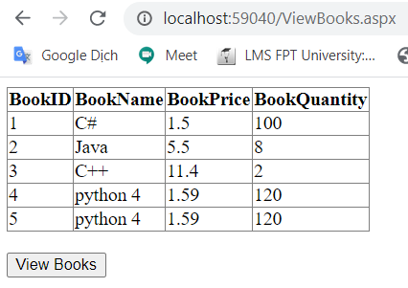
Demo

Slide 42
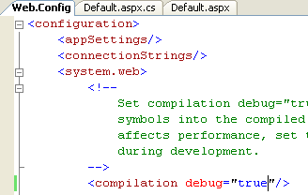
Debugging and Tracing ASP.NET Pages
Enable tracing support
Web.config

Slide 43
ASP.NET Website Directory Structure
Subfolder | Description
App_Browsers | Browser definition files that identify individual browsers and determine their capabilities.
App_Code | Folder for source code for components or classes that you want to compile as part of your application
App_Data | Folder for storing Access *.mdb files, SQL Express *.mdf files, XML files, or other data stores.
App_GlobalResources | Folder for *.resx files that are accessed programmatically from application code
App_LocalResources | Folder for *.resx files that are bound to a specific page.
App_Themes | Define the appearance of ASP.NET web pages and controls.
App_WebReferences | Folder for proxy classes, schemas, and other files associated with using a web service in your application.
Bin | Folder for compiled private assemblies (*.dll files). Assemblies in the Bin folder are automatically referenced by application.

Slide 44
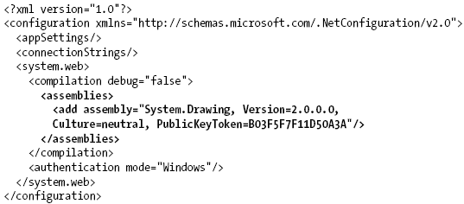
ASP.NET Website Directory Structure
The Role of the Bin Folder
When you reference a private assembly, Visual Studio 2005 will automatically create a Bin directory within directory structure to store a local copy of the binary
Web.config file is automatically created to records the shared assembly within the <assemblies> element.

Slide 45
ASP.NET Website Directory Structure
The Role of the App_Code Folder
Used to place source code files that are not directly tied to a specific web page (such as a code-behind file) but are to be compiled for use by your website.
A single App_Code folder can contain code files from multiple languages.
The App_Code directory will also be used to contain files that are not language files, but are useful nonetheless (*.xsd files, *.wsdl files, etc.).

Slide 46
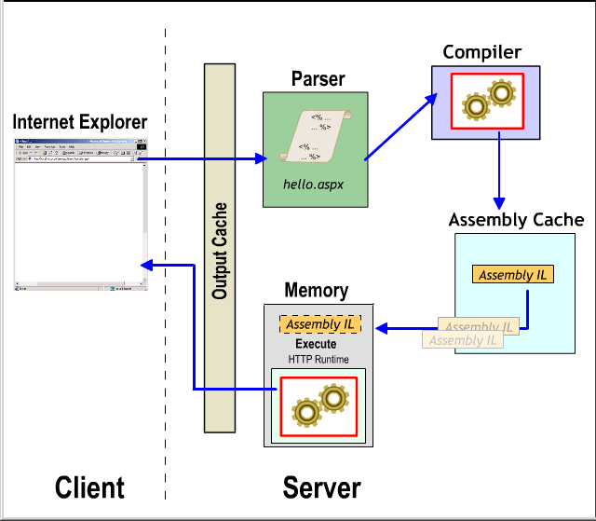
ASP.NET Compilation Model
Just edit the code and hit the page
ASP.NET will automatically compile the code into an assembly
Compiled code is cached in the CLR Assembly Cache
Subsequent page hits use compiled assembly
If the text of the page changes then the code is recompiled
Works just like ASP: edit, save and run

Slide 47
ASP.NET 2.0 Page Compilation Cycle
Regardless of which page model is used (single-file or code-behind), *.aspx files (and any related code-behind file) are compiled on the fly into a valid .NET assembly.
This assembly is then hosted by the ASP.NET worker process (aspnet_wp.exe) within its own application domain boundary.

Slide 48
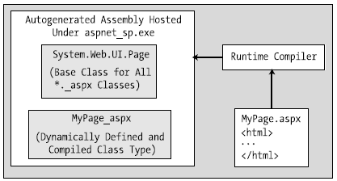
ASP.NET 2.0 Page Compilation Cycle
Compilation Cycle for Single-File Pages
HTML markup, <script> blocks, and web control definitions are dynamically compiled into a class type deriving from System.Web.UI.Page
This dynamically compiled assembly is deployed to a runtime-defined subdirectory under the <%windir%>Microsoft.NET\Framework\v2.0.50215\Temporary ASP.NET Files\root directory.

Slide 49
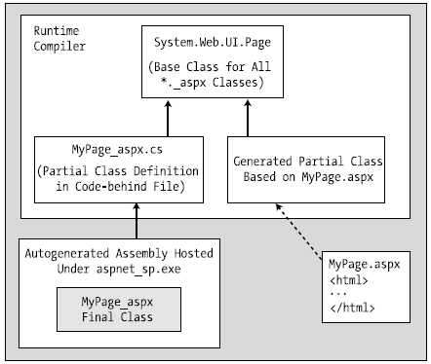
ASP.NET 2.0 Page Compilation Cycle
Compilation Cycle for Multifile Pages
The compilation process of a page is similar to that of the single-file model.
The type deriving from System.Web.UI.Page is composed from three files rather than the expected two.

Slide 50
The Incoming HTTP Request
ASP.NET does not support an object named Request.
All ASP.NET pages do inherit the System.Web.UI.Page.Request property, which provides access to an instance of the HttpRequest class type.

Slide 51
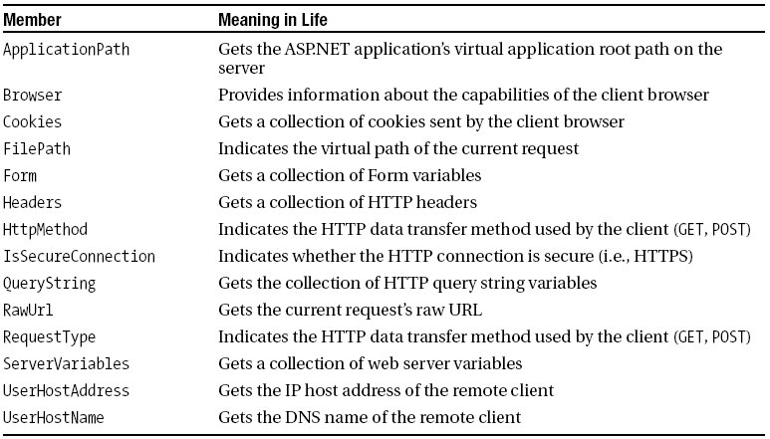
The Incoming HTTP Request
Members of the HttpRequest Type

Slide 52
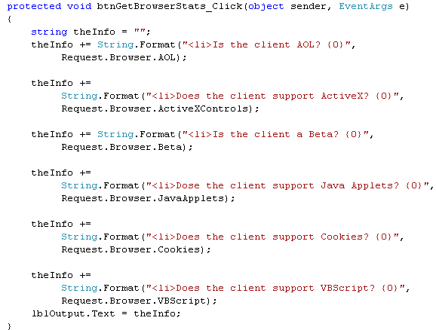

Obtaining Brower Statistics Demo (Ch_23 code\FunWithPageMembers)
Notes:
Gets a value indicating whether the client is an America Online (AOL) browse

Slide 53


The Incoming HTTP Request
Access to Incoming Form Data
The HttpRequest.Form and HttpRequest.QueryString
The Text property of the server-side widget:

Slide 54
The Incoming HTTP Request
The IsPostBack Property:
“postback” refers to the act of returning to a particular web page while still in session with the server.
The IsPostBack property will return true if the current HTTP request has been sent by a currently logged on user and false if this is the user’s first interaction with the page.
Postback is most helpful when you wish to perform a block of code only the first time the user accesses a given page.

Slide 55

The Incoming HTTP Request
The IsPostBack Property:

Slide 56


Lab WebFrom & ADO.NET

Slide 57

The Outgoing HTTP Response
The HttpResponse type defines a number of properties that allow to format the HTTP response sent back to the client browser.
Properties of the HttpResponse Type

Slide 58



Redirecting Users (Ch_23 code\FunWithPageMembers)
HttpServerUtility.Transfer(): more efficient in case of
transfer control to a *.aspx file in the same virtual directory.

Slide 59
Life Cycle of an ASP.NET Web Page
Event | Description | Application
PreInit | The framework uses this event to allocate any web controls, apply themes, establish the master page, and set user profiles. | Create /recreate dynamic controls. Set a master page or theme dynamically
Init | The framework uses this event to set the properties of web controls to their previous values via postback or view state data | Used to read or initialize your control properties.
Load | When this event fires, the page and its controls are fully initialized, and their previous values are restored. | used to set properties and make database connections
“Event that triggered the postback” | This “event” simply refers to whichever event caused the browser to perform the postback to the web server (such as a Button click). | Handle event
PreRender | All control data binding and UI configuration has occurred and the controls are ready to render their data into the outbound HTTP response. | used to make any ‘last chance’ changes to the controls before they are rendered.
Unload | The page and its controls have finished the rendering process, and the page object is about to be destroyed. | Closing files, database connections, etc.
More: http://msdn.microsoft.com/en-us/library/ms178472.aspx

Slide 60
Categories of ASP.NET Web Controls
Simple controls
(Feature) Rich controls
Data-centric controls
Input validation controls

Slide 61
Building a Simple ASP.NET 2.0 Website
Working with master pages
Working with the Menu control
Working with the GridView control
Working with the Wizard control

Slide 62
Building a Simple ASP.NET 2.0 Website
Master Pages
Master page provides a consistent look and feel across multiple pages (a common menu navigation system, common header and footer content, company logo, etc.).
A master page is little more than an ASP.NET page that takes a *.master file extension.
Master pages are not viewable from a client-side browser (in fact, the ASP.NET runtime will not server this flavor of web content).
Master pages define a common UI frame shared by all pages (or a subset of pages) in your site.

Slide 63


Demo Master Page

Slide 64

Demo Master Page
Right-click on project | Add | New Item

Slide 65



Demo Master Page
Right-click on project | Add | New Item
add “my.css”

Slide 66


Demo Master Page

Slide 67

Demo Master Page
Right-click on project | Add | New Item

Slide 68

Demo Master Page
Choose the MySite.Master

Slide 69

Demo Master Page
Book.aspx page

Slide 70


Design Master Page

Slide 71


Any asp .net page that uses this master page will have this part
Now, build a menu for the master page
This will be placed by any content of any web page
Other pages use this master page by placing this id in their code

Slide 72




Design Menu
Drag to here
Add one item
Add child item
This page will be loaded when “Home” is clicked

Slide 73


Default.aspx
This is the whole content of the Default.aspx page
Add content for the Default.aspx page

Slide 74


Inventory.aspx
Use master page like the Default.aspx
Use this control (GridView) to display data

Slide 75


Inventory.aspx: design GridView
1
2

Slide 76


Inventory.aspx: design GridView
4
3

Slide 77


Inventory.aspx: design GridView
5
6
Store connection info in database

Slide 78


Inventory.aspx: design GridView
7
8

Slide 79


Inventory.aspx: design GridView
9

Slide 80


BuildCard.aspx
1

Slide 81


BuildCard.aspx
2

Slide 82





BuildCard.aspx
3.1
3.2
3.4
3.3

Slide 83



Slide 84
Validation Controls
Client-side form validation is quite useful in that you can ensure that various constraints are in place before posting back to the web server, thereby avoiding expensive round-trips.
Validator controls are not used to emit HTML, but are used to emit client-side JavaScript (and possibly server-side operations) for the purpose of form validation.
Control | Description
CompareValidator | Validates that the value of an input control is equal to a given value of another input control or a fixed constant.
CustomValidator | Allows you to build a custom validation function that validates a given control.
RangeValidator | Determines that a given value is in a predetermined range.
RegularExpressionValidator | Checks if the value of the associated input control matches the pattern of a regular expression.
RequiredFieldValidator | Ensures that a given input control contains a value
ValidationSummary | Displays a summary of all validation errors of a page in a list, bulleted list, or single-paragraph format. The errors can be displayed inline and/or in a pop-up message box.

Slide 85
Validation Controls
Common Properties of the ASP.NET Validators
Member | Description
ControlToValidate | Gets or sets the input control to validate
Display | Gets or sets the display behavior of the error message in a validation control
EnableClientScript | Gets or sets a value indicating whether client-side validation is enabled
ErrorMessage | Gets or sets the text for the error message
ForeColor | Gets or sets the color of the message displayed when validation fails

Slide 86


Config for validation on .NET 4.5

Slide 87


Validation Controls Demo (Ch_23 code\ValidatorCtrls)

Slide 88

Validation Controls Demo (Ch_23 code\ValidatorCtrls)
RequiredFieldValidator

Slide 89

Validation Controls Demo (Ch_23 code\ValidatorCtrls)
RangeValidator

Slide 90

Validation Controls Demo (Ch_23 code\ValidatorCtrls)
RegularExpressionValidator

Slide 91

Validation Controls Demo (Ch_23 code\ValidatorCtrls)
CompareValidator

Slide 92
Enjoy yourself:
Validation Summaries

Slide 93
Summary
HTTP: a protocol for transferring HTML document
HTML: a markup language
Client-Side Scripting: JavaScript, VBScript
GET and POST method
ASP.NET Web Page Code Model: Single and Code-Behind
HTTP Request + HTTP Response
Building a Simple ASP.NET 2.0 Website: Master page, Menu, GridView, Wizard
Validation Controls: RequiredFieldValidator, RegularExpressionValidator, RangeValidator, CompareValidator

